Slide 1



FitNoQuit
GID – 9
Bhavik Bhatt – 1814007
Piyush Chavda – 1814010
Bharat Choithani – 1814011
Muskaan Nandu – 1814020
Project Guide: Prof. Sonali Patil

Slide 2
Problem Statement
To recommend personalized, customized and sustainable diet plan to users based on their preferences
To recommends personalized and suitable workout to every individual.
Suggest blogs to users based on their category likings.

Slide 3
Literature Review
Sr. No​ | Topic​ | Aim​ | Conclusion​ | Disadvantages
1​ | An e-Health Monitoring System with Diet and Fitness Recommendation using Machine Learning [1] ​ | Paper proposes a system that aims at improving the health of the patients suffering from various diseases by recommending them healthier diet and exercise plans by analyzing and monitoring health parameters and the values from their latest reports related to the disease. Authors have considered patients suffering from either Diabetes or Blood pressure or Thyroid | The paper deals with health monitoring of disease like Diabetes, Blood Pressure, and Thyroid based on the patient’s latest report looking for improvements in every follow-up session and recommending suitable and updated diet and exercise plan in each follow-up session based on the reports and other credentials like height, weight, age, activity level, using the Machine Learning technique i.e. C4.5 decision tree algorithm. | The system suggests diet and workout by taking into account parameters and values related to diseases only. Not suitable for other sets of users (No disease).

Slide 4
Sr. No​ | Topic​ | Aim​ | Conclusion​ | Disadvantages
2 | A Food Recommender System Considering Nutritional Information and User Preferences​ [2] | This paper presents a general framework for daily meal plan recommendations with the simultaneous management of nutritional-aware and preference-aware information. The proposal incorporates a pre-filtering stage that uses AHPSort as multi-criteria decision analysis tool for filtering out foods which are not appropriate to the current user characteristics. Furthermore, it incorporates an optimization-based stage for generating a daily meal plan whose goal is the recommendation of food highly preferred by the user, not consumed recently, and satisfying his/her daily nutritional requirements.​ | The current paper has presented a food recommendation approach focused on generating daily personalized meal plans for the users, according to their nutritional necessities and previous food preferences. It presents a general architecture for food recommendation, composed by an information gathering layer, the user profile dataset, the intelligent system layer, and an end user interface.​ | Does not take into account health conditions of the users.
3 | Diet-Right: A Smart Food Recommendation System [3] | A cloud based food recommendation system, called Diet-Right, for dietary recommendations based on users’ pathological reports. The model uses ant colony algorithm to generate optimal food list and recommends suitable foods according to the values of pathological reports​ | The experimental results show that compared to single node execution, the convergence time of parallel execution on cloud is approximately 12 times lower. Moreover, adequate accuracy is attainable by increasing the number of ants​ | Does not recommend workout to users.

Slide 5
​ | Topic​ | Aim​ | Conclusion​ | Disadvantages
4 | A Personalized Healthy Diet Recommender System​ [4] | The main aim is to develop a method to provide every user with meals of their choice, while ensuring that the correct proportion of nutrients are present in them. This is done by developing a diet recommendation system which recommends a healthy and appropriate food quantity to ​users.​ | The system presented is made up of two parts: the first part provides content based diet recommendation while the second part uses Pearson Correlation Coefficient to compare food nutrients and recommends alternative food items, thus allowing users to make choices. Thus, a system that considers an individual’s daily energy requirement in order to maintain a healthy weight and reduce the risk of chronic diseases has been developed by considering the food preferences of the user.​ | The system did not consider any existing health issues that a user might be dealing with.
5 | Website on Diet Recommendation Using Machine Learning​ [5] | The objective of this study is to consider various important aspects of the user's lifestyle while recommending a healthy and nutritious diet for the user and encouraging user to incorporate physical activity in their lifestyle.​ | The system has 3 phases: Information Collection Phase, Learning Phase and Recommendation Phase. The learning phase makes use of 2 ML Algorithms: K-Means and Random Forest to predict food items based on user inputs. The system will recommend diet in 3 categories: Breakfast, Lunch and Dinner. The users can choose from the multiple recommendations and a comparison of calories will be shown to the user based on which user can design a diet plan.​ | The users have to create their own diet plan by comparing the calories of suggested food items from a calorie table.

Slide 6
What’s different in FitNoQuit?
Existing Systems​ | Features of the system | Potential problems with existing systems. | How FitNoQuit solves the issue?
Fittr | Fittr is a fitness community where people share, learn and discuss fitness. It provides articles, recipes and nutrition facts to users. | These articles are just facts and are not customized to the user’s needs. | FitNoQuit would provide users with customized diets and workouts to reach a certain fitness goal, along with articles on fitness and nutritional facts.
Cure Fit | cure.fit is a health and fitness company offering digital and offline experiences across fitness. They provide in-class and group workouts with a live trainer. | 1. Workout needs to be carried out during the working hours of the trainers so timings are less flexible. 2. No personalized diet recommendations are provided. | 1. With FitNoQuit users get customized workout plan, which they can follow at a time convenient to them. 2. FitNoQuit also provides customized diet plans which is one of the most important ingredient to healthy life, becoming a one stop destination to achieve your health goals.
Google Fit | Google Fit helps achieve your fitness goals through customised coaching and actionable tips based on your health and activity history | It is more of an Activity Tracker, does not give any recommendations. | FitNoQuit would provide users with customized diets and workouts to reach a certain fitness goal, along with articles on fitness and nutritional facts.
HealthifyMe | It is a lifestyle tracker, which allows you to track your nutrition and plan your diet. | Healthify me gives users a workout plan for their goals but asks the user to select the no. of calories they wish to burn. | FitNoQuit considers that a user might not have know how many calories to loose. Thus it calculates the amount of calories they need to burn based on their fitness goal and BMI and provides various workout options to choose from.

Slide 7
Functional Requirements
Non-Functional Requirements
SRS
Registration/Sign Up
Login/Sign In
User Profile
Workout Recommendation
Diet Recommendation
Blog Suggestions
Logout
Authorization
Speed
Portability
Compatibility
Security
Availability
Reliability

Slide 8
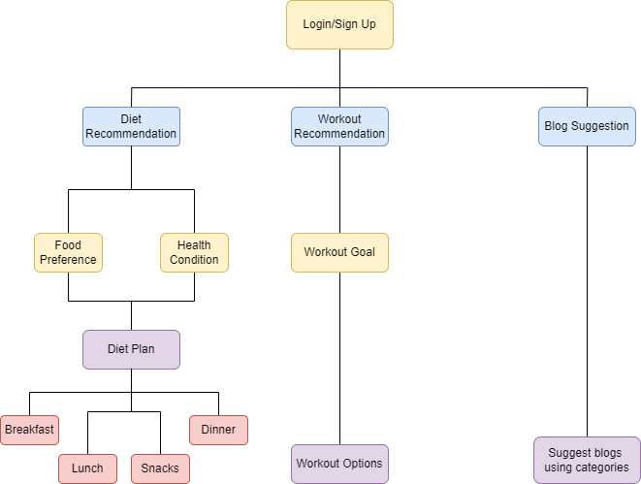
Software Design

Slide 9
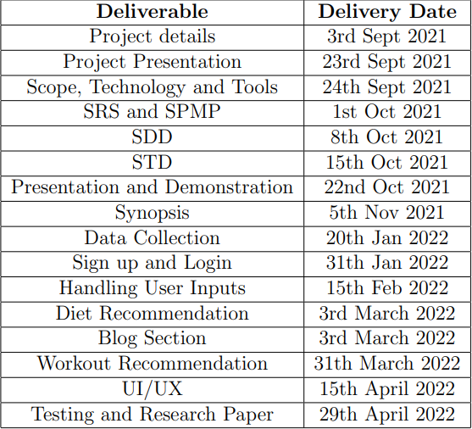
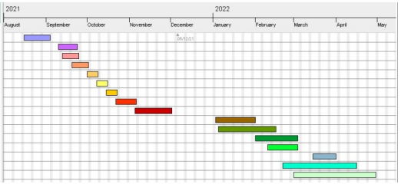
Timeline Chart

Slide 10
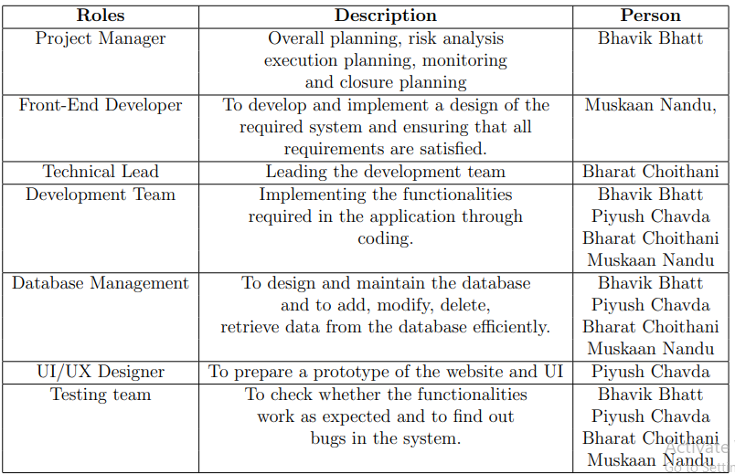
Responsibilities (SPMP)

Slide 11
Tech Stack​
MACHINE LEARNING​​
Python:
Scikit-Learn​​
Keras​​
Numpy​​
Pandas
WEB DEVELOPMENT​​
Django​​
HTML/CSS​​
MySQL​​

Slide 12
Implementation Details
Step 1: Research for material available over the internet (research papers, documents, datasets etc.)
Step 2: Create a customized dataset according to our use.
Step 3: Design UI layouts for our web app.
Step 4: Connect our web app to database.
Step 5: Train suitable machine learning models on our dataset and tune it according to our needs to recommend diet and workout plans.
Step 6: Suggest blogs to users based on categories.
Step 7: Implement our trained models in our web app.
Step 8: Recommend diet, workout plans to users using our trained model.
Step 9: Test for all functionalities.

Slide 13
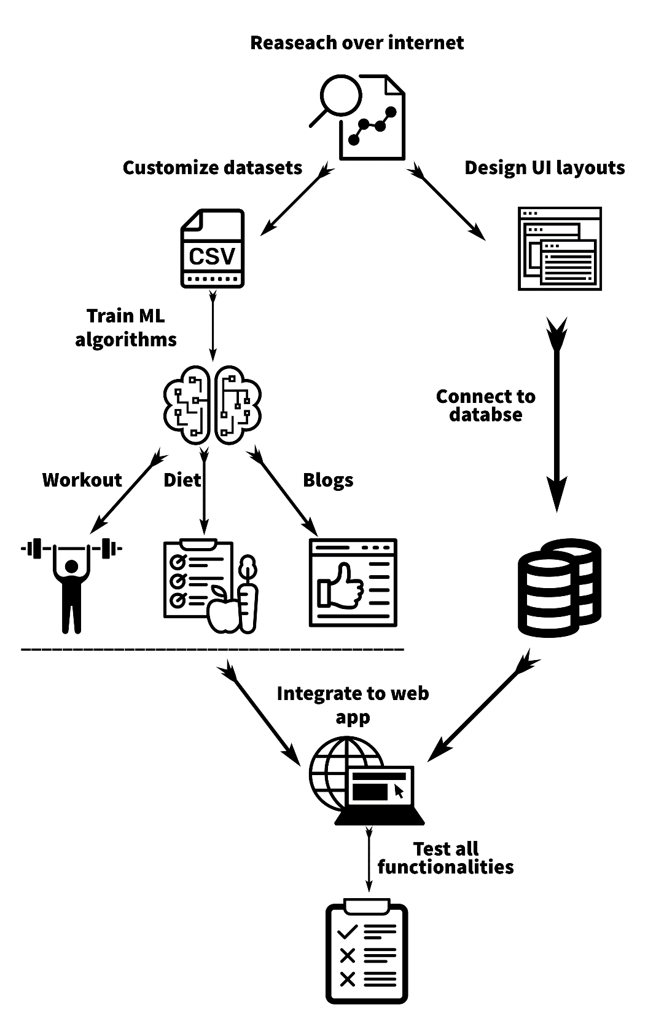
Implementation Details

Slide 14
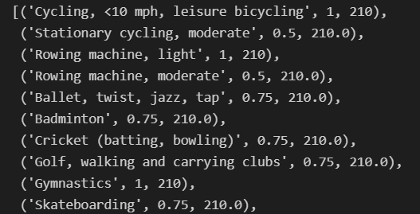
Result & Discussion
Lets say user’s end goal is to Lose weight. Then based on the information entered by the user, the system calculates the amount of calories the user needs to consume in a day.
Let total calorie intake be = 1500
The system would then suggest a diet with total calorie value of 1700, for example.
Based on this workout would be suggested to lose 200 calories and reach the final calorie count.
Below are a list of exercises with time duration that user should do to lose those 200 calories.
1 -> 60 mins (1 hour) of workout
0.75 -> 45 mins of given workout
0.5 -> 30 mins of given workout
A 20% calorie buffer is considered to suggest the exercises. Hence, workout burning calories between 180 to 220 are suggested.

Slide 15
Test Cases (STD)
Sign Up
Sign In
User Profile
Diet Recommendation
Workout Recommendation
Blog Community

Slide 16
References
[1] D. Mogaveera, V. Mathur and S. Waghela, "e-Health Monitoring System with Diet and Fitness Recommendation using Machine Learning," 2021 6th International Conference on Inventive Computation Technologies (ICICT), 2021, pp. 694-700, doi: 10.1109/ICICT50816.2021.9358605.
[2] R. Yera Toledo, A. A. Alzahrani and L. Martínez, "A Food Recommender System Considering Nutritional Information and User Preferences," in IEEE Access, vol. 7, pp. 96695-96711, 2019, doi: 10.1109/ACCESS.2019.2929413.
[3] F. Rehman, O. Khalid, N. u. Haq, A. u. R. Khan, K. Bilal and S. A. Madani, "Diet-Right: A Smart Food Recommendation System," KSII Transactions on Internet and Information Systems, vol. 11, no. 6, pp. 2910-2925, 2017. DOI: 10.3837/tiis.2017.06.006.
[4] Ojokoh, B., and A. Babalola. "A Personalized Healthy Diet Recommender System." Organization for Women in Science for the Developing World (OWSD) (2016): 388-393.
[5] Kardam, Shubham Singh, et al. "Website on Diet Recommendation Using Machine Learning." In International Research Journal of Engineering and Technology (IRJET) Volume: 08 Issue: 04, April 2021.

